Slide 1

FaceComm
Group # 14
VENKATA VAMSI KRISHNA BHUVANAM
SOWMYA YELMATI
SRAVANTHI DAMA
JEBREEL M KHURMI

Slide 2
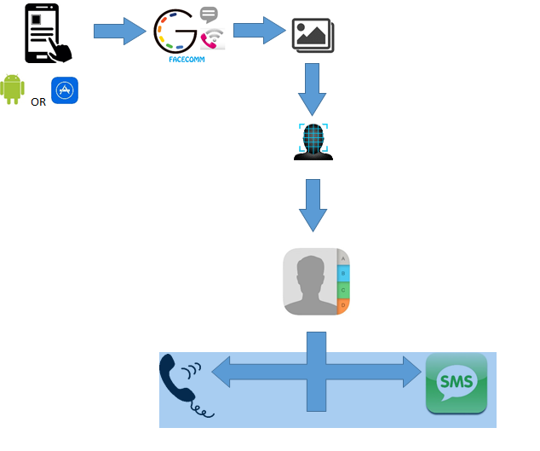
Architecture
Technologies Used
Programming/Scripting Languages : HTML, Angular JS , Node js, IONIC framework
Data Base : MongoDB
Application Programming interfaces (API) : Faceplusplus, Faceplusplus face detection, Faceplusplus Image matching, Mongo LabAPI.

Slide 3
Description
FaceComm is an Android Application which provides a call and message feature by clicking faces of images in a personalised Gallery.
This application can be installed as a normal gallery application and browse the images present or downloaded in the mobile .
Then the user may randomly select an image of his desire and click on the face .The face of the person is cropped into image canvas.
If the contact picture of the person already exists then an image matching/comparision takes place and gives an option of text or call.
Limitations
Still application is getting overloaded while checking for all contact pictures in address book (For Demo purpose we have checked particular contact and showed the result).
API is having bottleneck issue where some times, we get error while calling server.
In Current Version we were able to detect upto 4 faces in an image, it can enhance later for more than 4 faces.
Also in Android Address book we have minimum two types of contact storage,
One – Device Storage
Two – Gmail Storage
Three – WhatsApp Storage
Because of which we are facing issues while searching for multiple contacts.
Notes:
data

